Slide 1
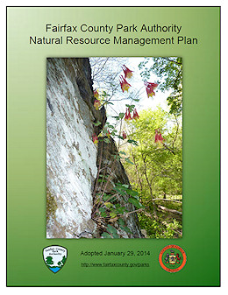
Stewardship of Our Resources

Slide 2
Community Engagement

Slide 3
Stewardship Education

Slide 4
Program Logo for HOLH

Slide 5
Educational Illustration for HOLH

Slide 6
Educational Products
Create web-based interaction and interpretation launched from the illustration.
Create an educational tool to take out to the public to interpret HOLH.
Create a traveling exhibit that explains the concept of natural capital resource management with HOLH.

Slide 7
Management Actions
We use current best practices for the management of the full natural system from soil to canopy. We also experiment with new options to find the best overall techniques for Fairfax County’s diverse holding of natural resource rich properties.
The Park Authority is partnering with multiple organizations to share results and improve the quality of natural resource management within our urban/suburban community.

Slide 8
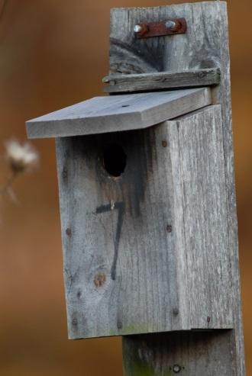
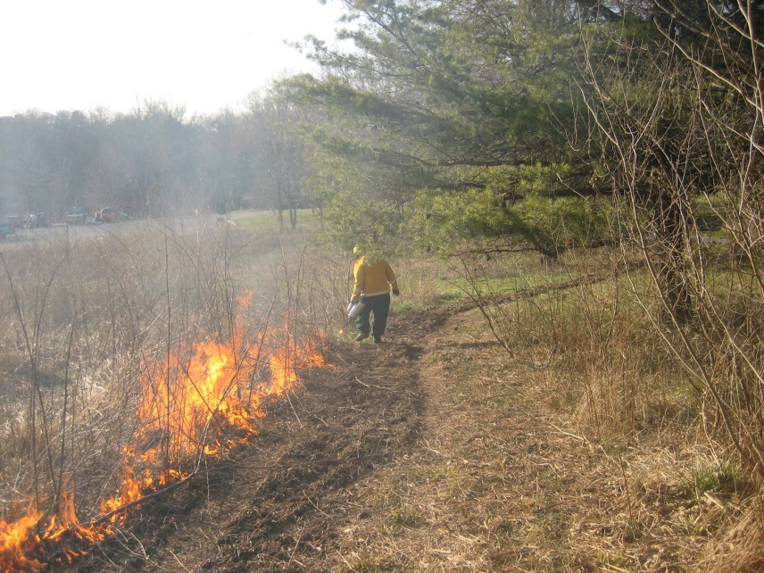
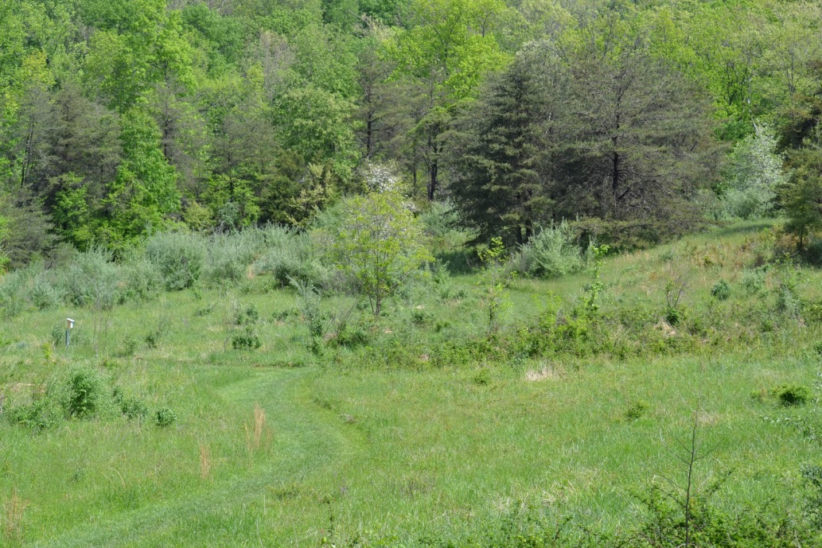
Middlegate Meadow Actions

Slide 9
Forestry Meadow Installation- Spring 2014

Slide 10
3 Months After Planting

Slide 11
Created Meadow - August 2014

Slide 12
Deer Management-FCPA/Contractor/Partners
Unhealthy Forest Floor of Japanese Stiltgrass
Deer Exclosure Fences-Regeneration of Native Plants

Slide 13
Deer Management Benefits
Diverse Forest Floor Plants Return
Purple Milkweed Appears – State Imperiled & Rare Fairfax Species

Slide 14
Forest Thinning Actions & Benefits

Slide 15
Fire as a Management Tool - Forests

Slide 16
Established Meadows

Slide 17
Experiment for Best Practices
Partnering with multiple NGO’s, County Agencies, Schools/Universities, Governments, and Contractors.
Actions are multi-faceted to ensure repeatable results.
Lessons learned will be applied other places to continue research and learning.
Further research and actions by partners will be fed back to the Park Authority to inform best practices by staff.
The Park Authority is receiving notoriety for managing open space in this way.
The Sully Stewardship Education Center concept includes lab space to be used by staff and partnering groups to continue informing how we manage natural resources in the best way.

