Slide 1
The Sully at Westfields
Special Exception for Sign Modifications
SE-2024-SU-00019
October 21, 2024
Joint Sully District Council Land Use and Transportation Committee Meeting

Slide 2
Site Specifics
4.34 acres
South of Glen Manor Drive, north of Sully Road (Route 28), and west of Westfields Boulevard (Route 662)
Commonwealth Centre
On October 19, 2021, the Board of Supervisors approved the replacement of the unbuilt portions of non-residential development in Land Bay A with residential uses, including 354 multi-family units on this site.

Slide 3
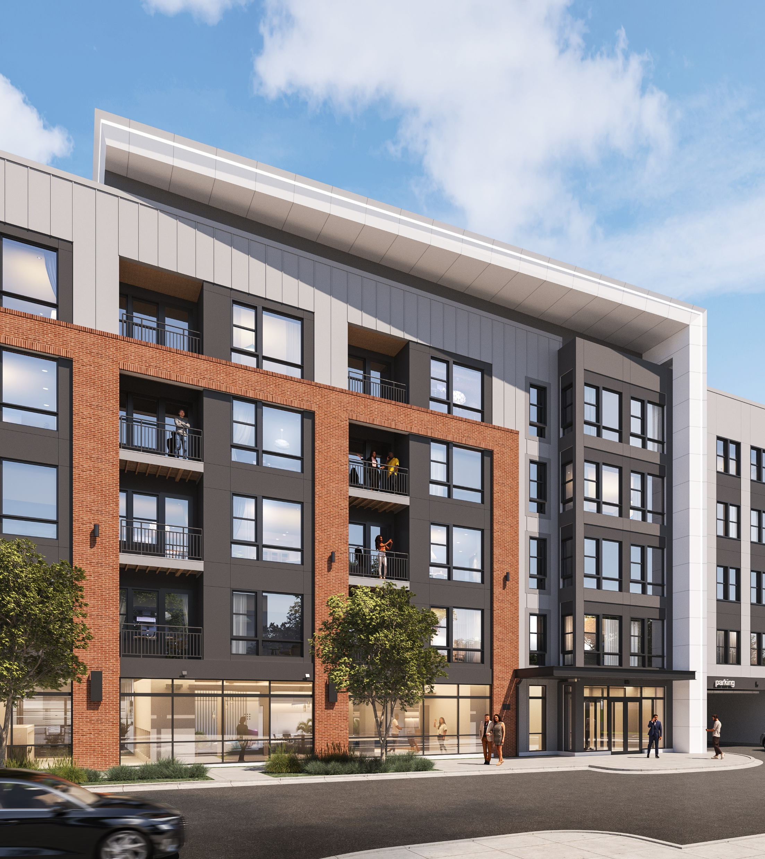
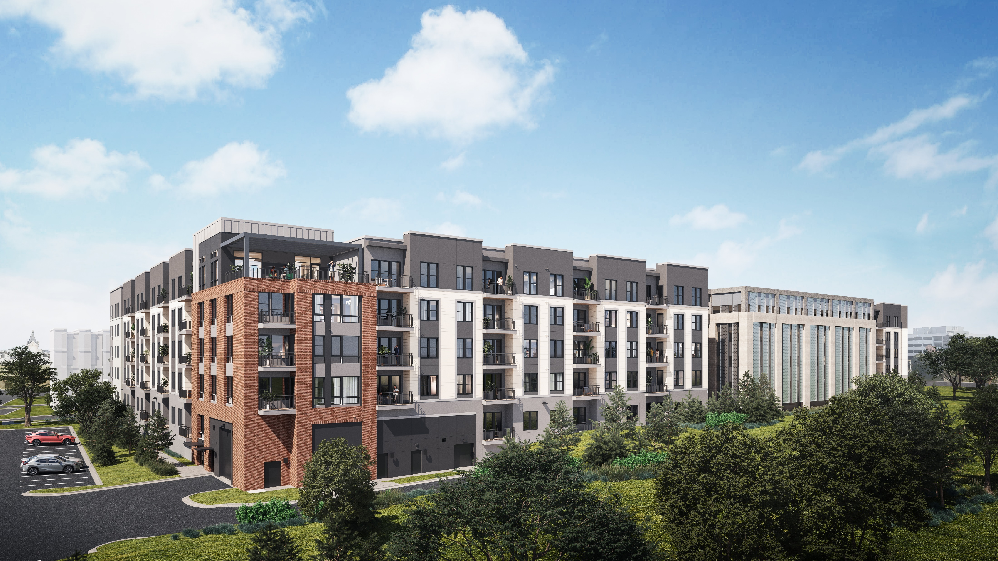
The Sully at Westfields

Slide 4
Previous Sign Approvals
CSP-2006-SU-025 was approved by the Planning Commission on February 18, 2009. This CSP provided guidance for the location, size, and material of various hotel, retail, office, direction, and regulatory signs for the 97.60-acre development.
CSPA-2006-SU-025 was approved by the Planning Commission on November 16, 2017. This still governs the non-residential signage within Commonwealth Centre (including the Property although it is no longer approved for non-residential uses).

Slide 5
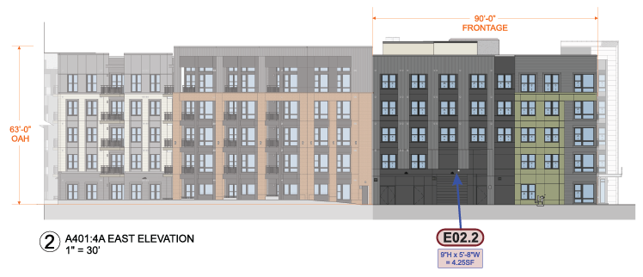
North & East Building Elevations
North Elevation
East Elevation

Slide 6
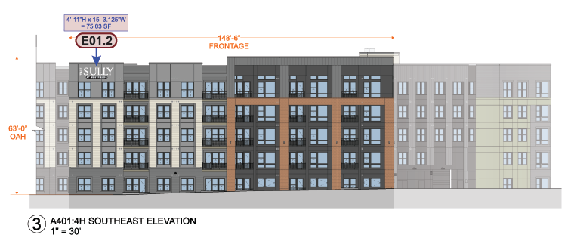
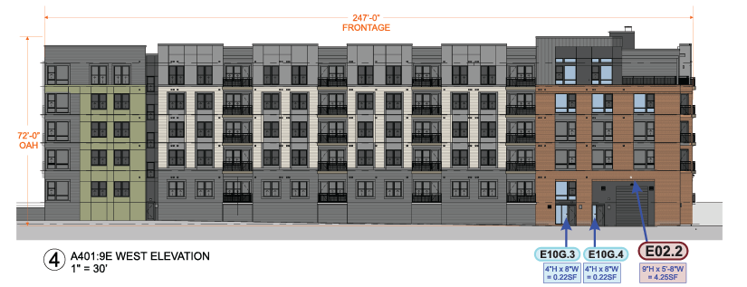
Southeast & West Building Elevations
Southeast Elevation
West Elevation

Slide 7
Signage Proposed

Slide 8
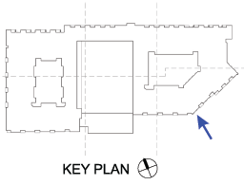
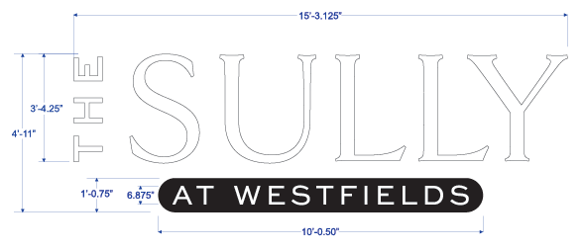
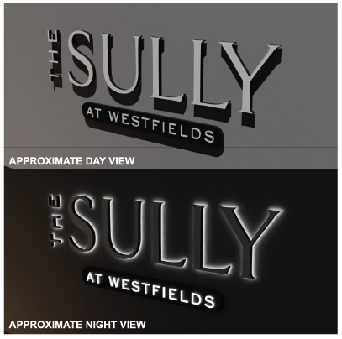
Building Identification Signage Southeast Elevation

Slide 9
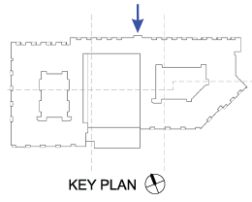
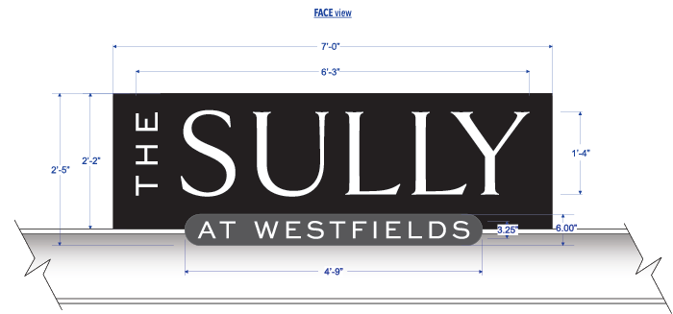
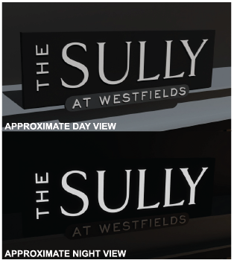
Building Identification Signage North Elevation

Slide 10
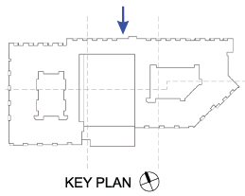
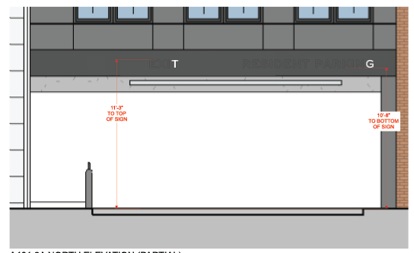
Parking Garage Identification Signs North Elevation

Slide 11
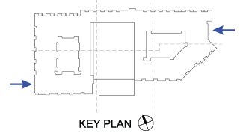
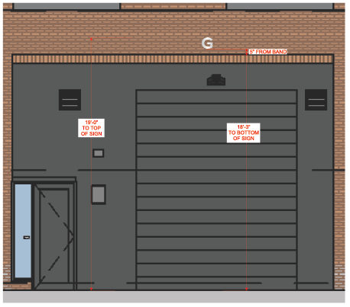
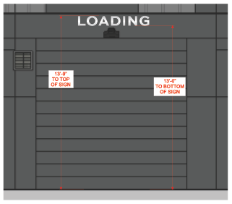
Parking Garage Identification Signs East and West Elevations
East Elevation
West Elevation

Slide 12
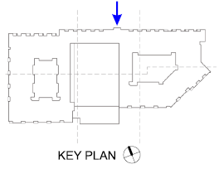
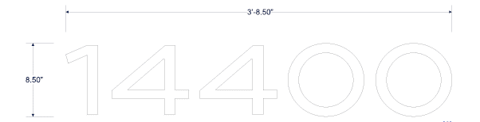
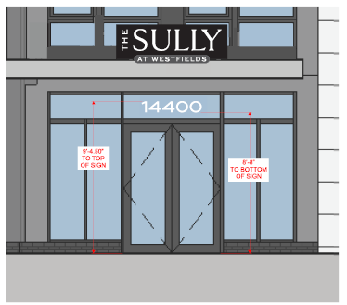
Address Number Signs North Elevation

Slide 13
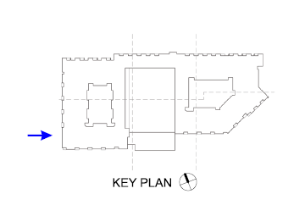
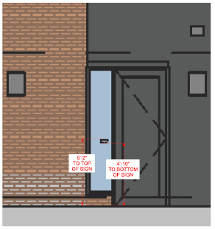
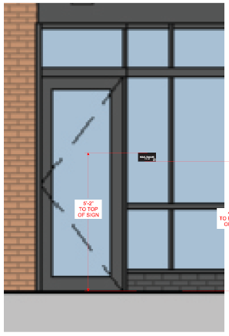
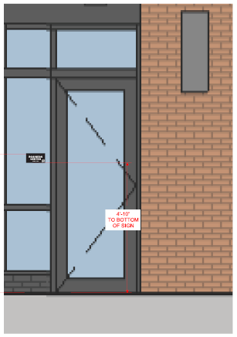
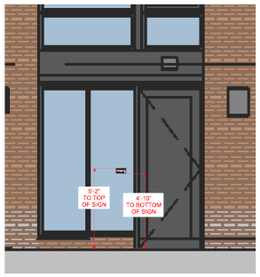
Exterior Room ID Signs North & West Elevations
Pet Spa Room -- West Elevation
Mail Room -- North Elevation
Business Center -- North Elevation
Bike Room -- West Elevation

Slide 14
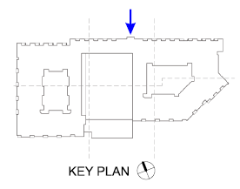
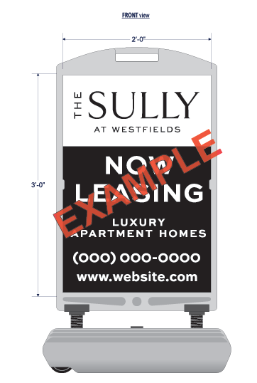
Temporary Signage

Slide 15
Questions?

